Slide 1
2 Corinthians 13
(English Standard Version)

Slide 2
(ESV) 13 This is the third time I am coming to you. Every charge must be established by the evidence of two or three witnesses. ² I warned those who sinned before and all the others, and I warn them now while absent, as I did when present on my second visit, that if I come again I will not spare them — ³ since you seek proof that Christ is speaking in me. He is not weak in dealing with you, but is powerful among you. ⁴ For he was crucified in weakness, but lives by the power of God. For we also are weak in him, but in dealing with you we will live with him by the power of God.

Slide 3
⁵ Examine yourselves, to see whether you are in the faith. Test yourselves. Or do you not realise this about yourselves, that Jesus Christ is in you? — unless indeed you fail to meet the test! ⁶ I hope you will find out that we have not failed the test. ⁷ But we pray to God that you may not do wrong — not that we may appear to have met the test, but that you may do what is right, though we may seem to have failed. ⁸ For we cannot do anything against the truth, but only for the truth. ⁹ For we are glad when we are weak and you are strong. Your restoration is what we pray for. ¹⁰ For this reason I write these things while I am away from you, that when I come I may not have to be severe in my use of the authority that the Lord has given me for building up and not for tearing down.

Slide 4
¹¹ Finally, brothers, rejoice. Aim for restoration, comfort one another, agree with one another, live in peace; and the God of love and peace will be with you. ¹² Greet one another with a holy kiss. ¹³ All the saints greet you.
¹⁴ The grace of the Lord Jesus Christ and the love of God and the fellowship of the Holy Spirit be with you all.

Slide 5
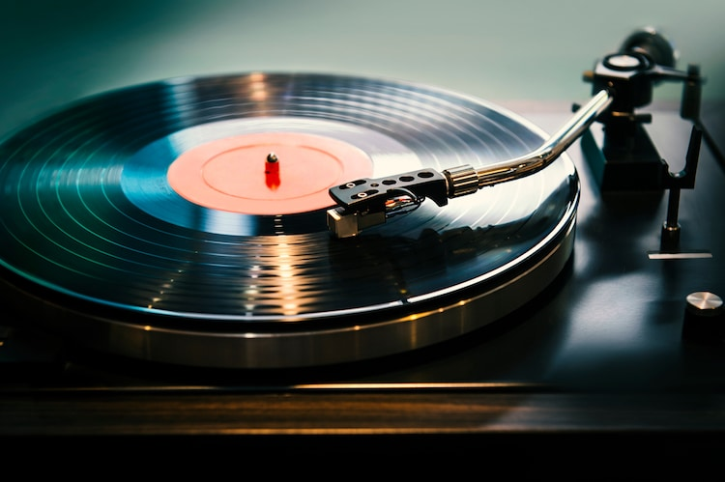
Paul’s Passion for: Jesus; The Gospel; Truth
Defending himself
Comparing himself to false Apostles
Pointing them towards Jesus
2 Corinthians and all
its warnings, are for our:
instruction
encouragement
formation into disciples of Christ
Build
the Church up
We pray that our thoughts will not be led astray from a sincere and pure devotion to Christ. And that when Jesus returns, we will be the pure bride that He’s coming for

Slide 6
Without repentance, the teachers and followers of the False Gospel, were heading for judgment
Paul warns them of their pending judgment. His hope they will repent before it’s too late.
Enough witnesses/evidence/warnings. It’s time for the church to deal with these false apostles.
Church discipline is an example of the Gospel and judgment of Christ.
Aim for restoration, but if no repentance/restoration, then judgment in the Power of God.
13 This is the third time I am coming to you. Every charge must be established by the evidence of two or three witnesses. ² I warned those who sinned before and all the others, and I warn them now while absent, as I did when present on my second visit, that if I come again I will not spare them....
^{Deuteronomy 19:15 (ESV) 15} “A single witness shall not suffice against a person for any crime or for any wrong in connection with any offense that he has committed. Only on the evidence of two witnesses or of three witnesses shall a charge be established.

Slide 7
Without repentance, the teachers and followers of the False Gospel, were heading for judgment
Paul warns them of their pending judgment. His hope they will repent before it’s too late.
Enough witnesses/evidence/warnings. It’s time for the church to deal with these false apostles.
Church discipline is an example of the Gospel and judgment of Christ.
Aim for restoration, but if no repentance/restoration, then judgment in the Power of God.
Excommunication – no longer welcome in the church, for failure to repent of serious sin
13 This is the third time I am coming to you. Every charge must be established by the evidence of two or three witnesses. ² I warned those who sinned before and all the others, and I warn them now while absent, as I did when present on my second visit, that if I come again I will not spare them....
Matthew 18: (ESV) ¹⁵ “If your brother sins against you, go and tell him his fault, between you and him alone. If he listens to you, you have gained your brother. ¹⁶ But if he does not listen, take one or two others along with you, that every charge may be established by the evidence of two or three witnesses. ¹⁷ If he refuses to listen to them, tell it to the church. And if he refuses to listen even to the church, let him be to you as a Gentile and a tax collector.

Slide 8
Without repentance, the teachers and followers of the False Gospel, were heading for judgment
Paul warns them of their pending judgment. His hope they will repent before it’s too late.
Enough witnesses/evidence/warnings. It’s time for the church to deal with these false apostles.
Church discipline is an example of the Gospel and judgment of Christ.
Aim for restoration, but if no repentance/restoration, then judgment in the Power of God.
Excommunication – no longer welcome in the church, for failure to repent of serious sin
Church discipline important. Prepares us for when Jesus returns in power to judge the world.
A church who have lost their fear of God → disobedience and a rejection of Christ
Matthew 7: (ESV) ²¹ “Not everyone who says to me, ‘Lord, Lord,’ will enter the kingdom of heaven, but the one who does the will of my Father who is in heaven. ²² On that day many will say to me, ‘Lord, Lord, did we not prophesy in your name, and cast out demons in your name, and do many mighty works in your name?’ ²³ And then will I declare to them, ‘I never knew you; depart from me, you workers of lawlessness.’

Slide 9
Without repentance, the teachers and followers of the False Gospel, were heading for judgment
Paul warns them of their pending judgment. His hope they will repent before it’s too late.
Enough witnesses/evidence/warnings. It’s time for the church to deal with these false apostles.
Church discipline is an example of the Gospel and judgment of Christ.
Aim for restoration, but if no repentance/restoration, then judgment in the Power of God.
Excommunication – no longer welcome in the church, for failure to repent of serious sin
Church discipline important. Prepares us for when Jesus returns in power to judge the world.
A church who have lost their fear of God → disobedience and a rejection of Christ
⁵ Examine yourselves, to see whether you are in the faith. Test yourselves. Or do you not realise this about yourselves, that Jesus Christ is in you? — unless indeed you fail to meet the test!
What prevents us from truly “Being in the faith”
A human religious perversion of the Gospel – in a religion but no relationship with Christ
A Self-Saving Gospel – “I don’t need a saviour because I’m a good person”
Emptying of the cost of Discipleship – Easy Believism – Belief but no fruit of transformation
Human-given unfounded assurance – Once Saved Always Saved – I can’t be lost
Truth and the Presence of Jesus – Signs of a Church “in the Faith”

Slide 10
Without repentance, the teachers and followers of the False Gospel, were heading for judgment
Paul warns them of their pending judgment. His hope they will repent before it’s too late.
Church discipline important. Prepares us for when Jesus returns in power to judge the world.
A church who have lost their fear of God → disobedience and a rejection of Christ
What prevents us from truly “Being in the faith”
A human religious perversion of the Gospel – in a religion but no relationship with Christ
A Self-Saving Gospel – “I don’t need a saviour because I’m a good person”
Emptying of the cost of Discipleship – Easy Believism – Belief but no fruit of transformation
Human-given unfounded assurance – Once Saved Always Saved – I can’t be lost
Truth and the Presence of Jesus – Signs of a Church “in the Faith”
1. A church of truth – contentment found in knowing the true Jesus
2. A church who reconcile and who unite in Christ
3. A church who rejoice in the restoration of those who sin – no joy in the fallen away
4. A church of shared fellowship – delight in fellowshipping with one another
Comfort one another;
Agree with one another;
Live in peace with one another;
a holy affection for one another

